Slide 1
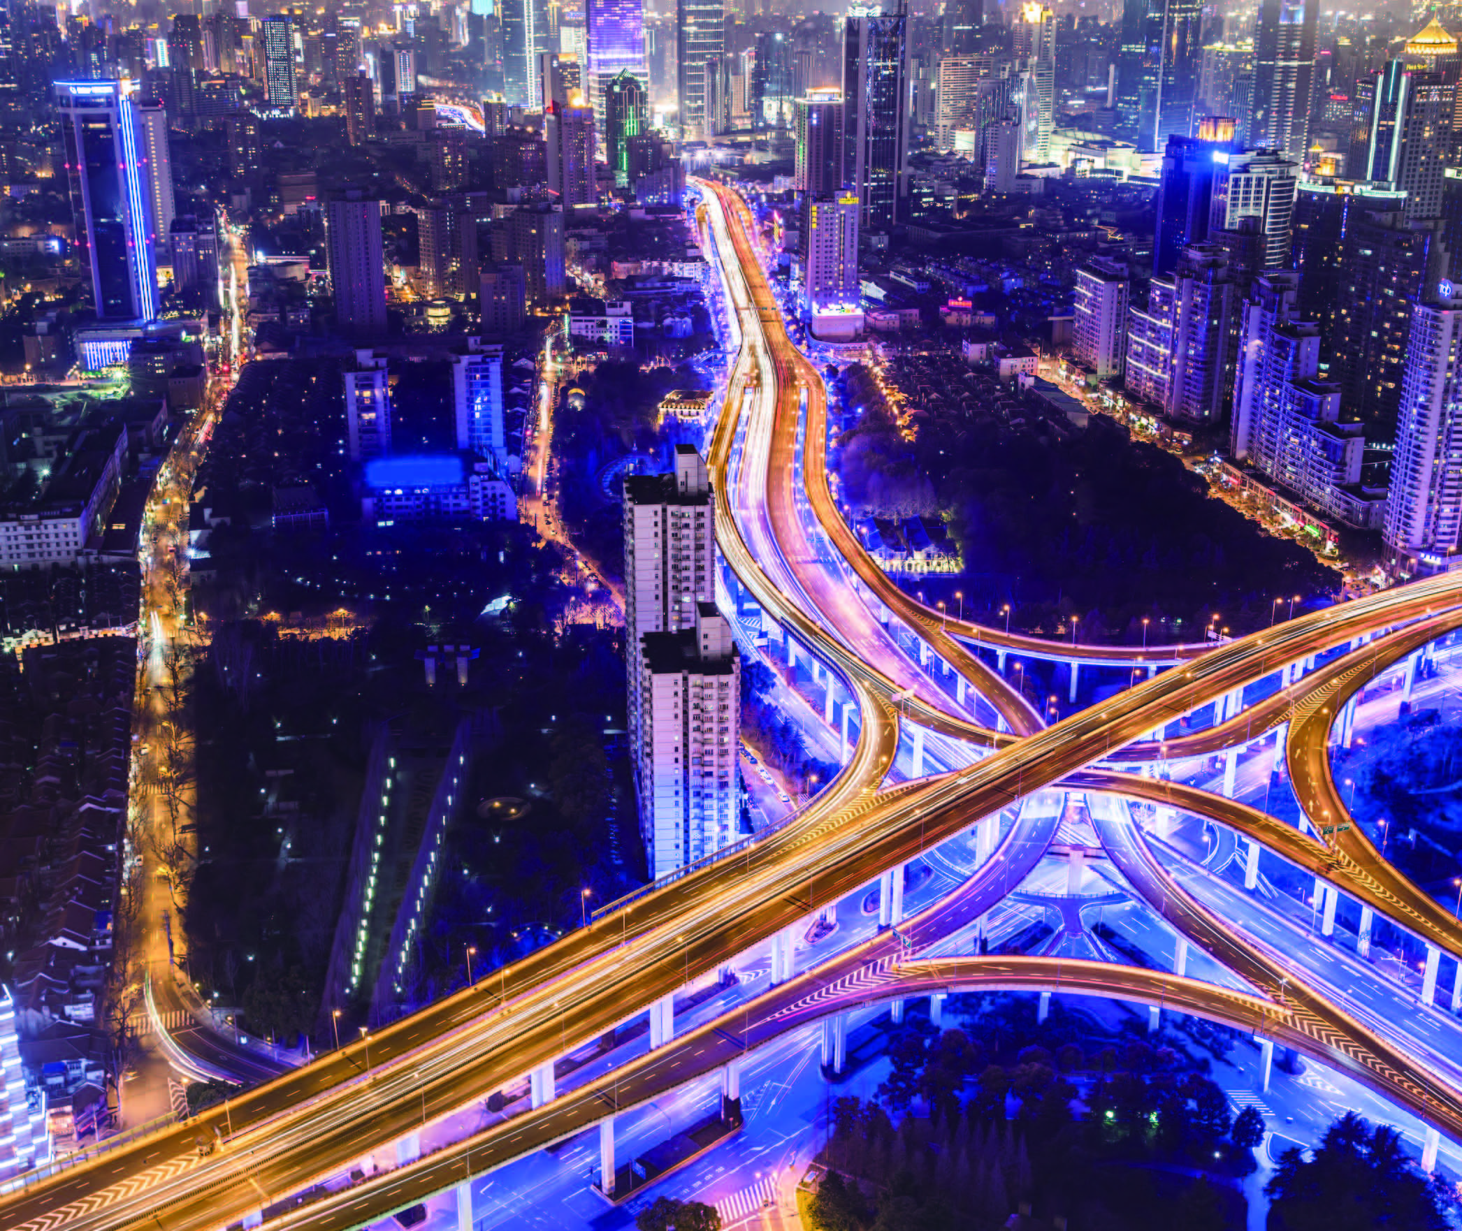
UNIT 5
Urban pulse

Slide 2
Unit 5 Urban pulse
Learning objectives
Opening up
Listening to the world
Speaking for communication
Further practice in listening
Wrapping up
Fun time

Slide 3

Learning objectives
1
talk about city life
2
understand pros and cons
3
make and respond to complaints
4
recommend the best city to live in

Slide 4
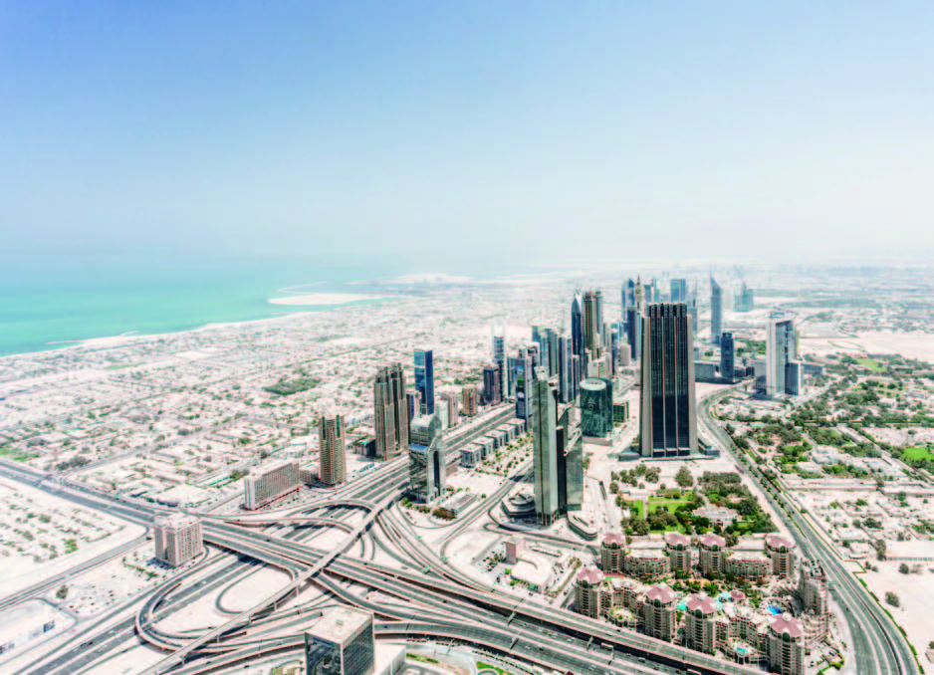
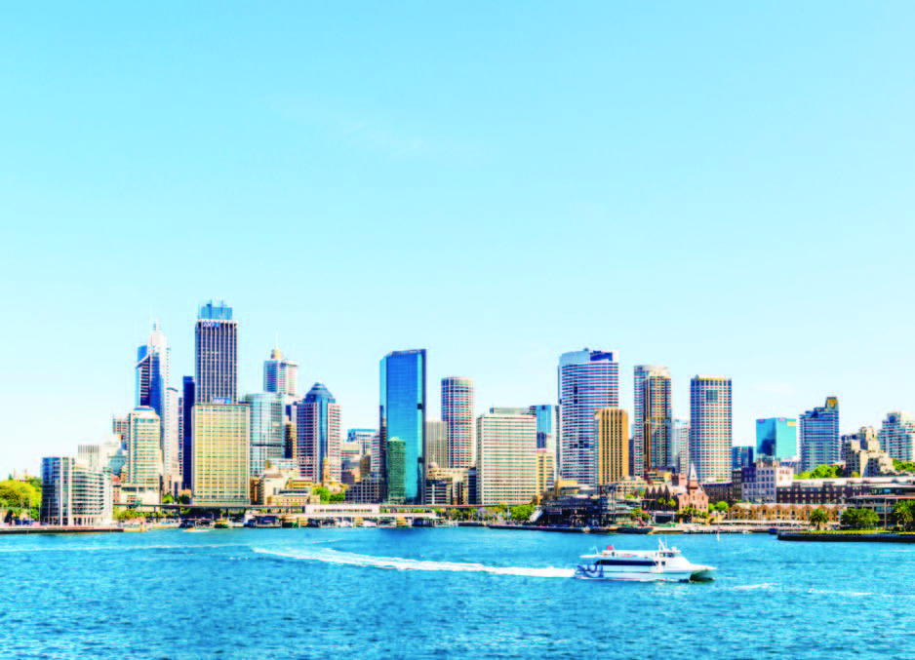
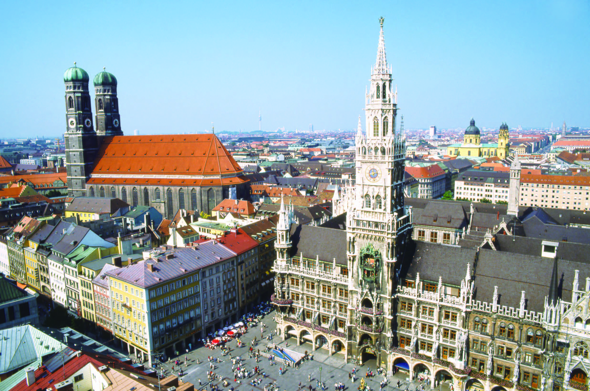
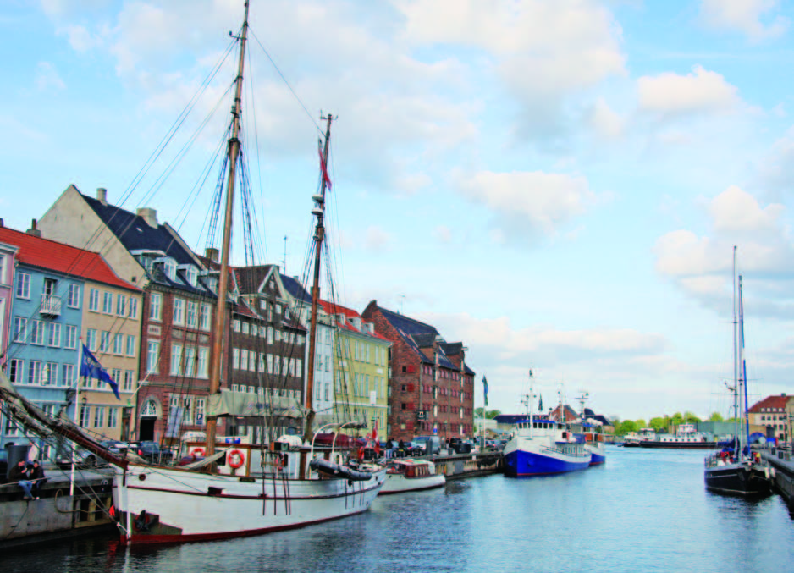
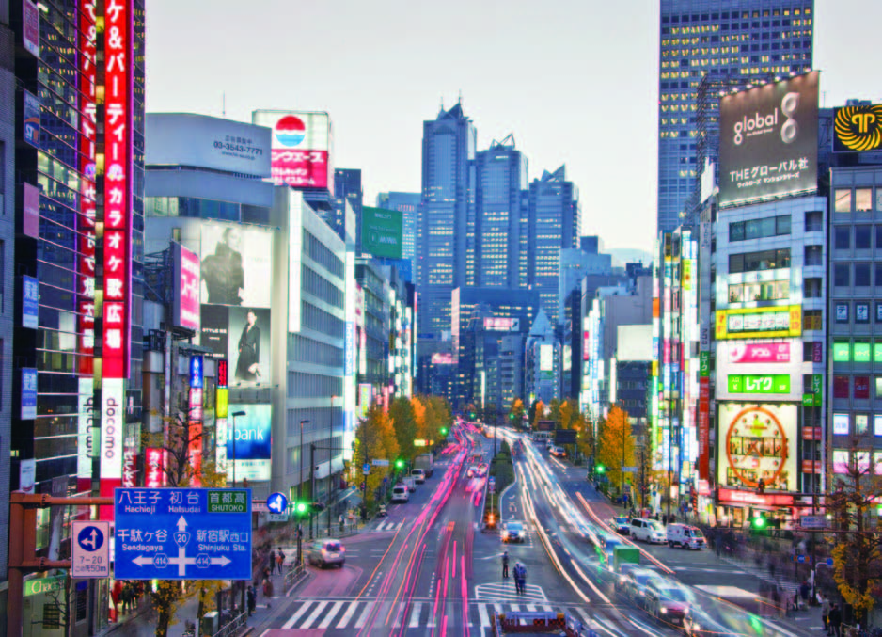
Opening up
Look at the pictures. Work in pairs and discuss. Which city is the best city for living in your mind? Why?
Munich (慕尼黑)
Sydney (悉尼)
Dubai (迪拜)
Copenhagen (哥本哈根)
Tokyo(东京)

Slide 5
Opening up
Look at the pictures. Work in pairs and discuss. Which city is the best city for living in your mind? Why?
I think Copenhagen is the best city for living.
Accommodation in Copenhagen is cheaper than in many other European capitals;
Public transport is well organized;
Copenhagen has a rich cultural life;
Flexible work culture and extensive, affordable childcare system.
Copenhagen (哥本哈根)

Slide 6
Opening up
Look at the pictures. Work in pairs and discuss. Which city is the best city for living in your mind? Why?
I think Tokyo is the best city for living.
There is no end to the vast array of entertainment, arts and culture experiences;
Tokyo has excellent and reliable public transportation;
Tokyo is also one of the safest capitals in the world.
Tokyo(东京)

Slide 7
Opening up
Look at the pictures. Work in pairs and discuss. Which city is the best city for living in your mind? Why?
I think Munich is the best city for living.
Munich is a green city thanks to its many parks;
Munich enjoys an excellent level of health;
Life in Munich is significantly cheaper;
Munich has an excellent and reliable public transportation system;
Munich is a prosperous big city with a cozy small-town atmosphere.
Munich (慕尼黑)

Slide 8
Listening to the world
Sharing
Listening
Viewing

Slide 9
Listening to the world
Sharing
1
Watch a podcast for its general idea.
The podcast is mainly about whether people enjoy city life, the good things about living in a city and the main problems in cities.
2
Watch Part 1 and fill in the blanks.
1) cities
2) mix of people
3) peace and quiet

Slide 10
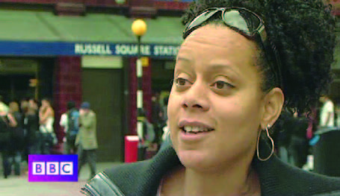
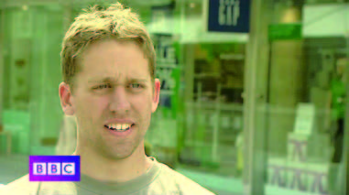
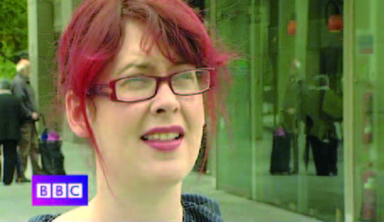
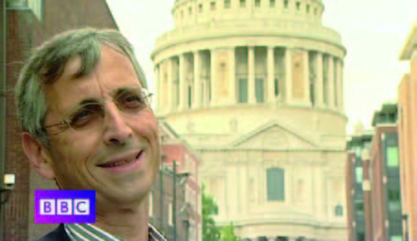
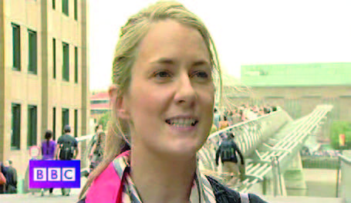
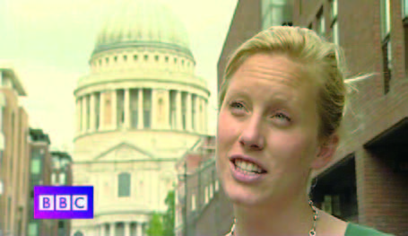
Listening to the world
Sharing
3
Watch Part 2 and match the statements.
1
2
C
F
3
4
D
A
5
6
B
E

Slide 11
Listening to the world
Sharing
4
Watch Part 3 and check the true statements.
1
√
√
2
A
B
3
4
C
D
√
5
E

Slide 12
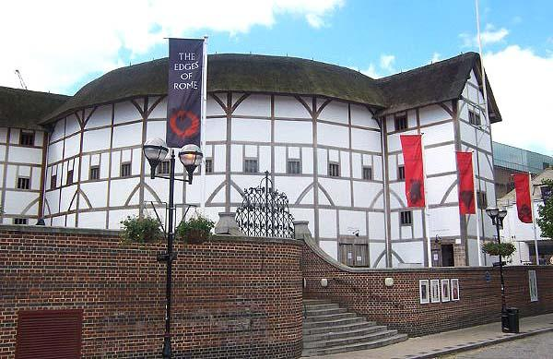
Listening to the world
Cultural Notes
Globe Theater It is a theater in London associated with William Shakespeare. It was built in 1599 by Shakespeare’s playing company, and was destroyed by fire in 1613. A second Globe Theater was built on the same site by 1614 and closed in 1642. A modern reconstruction of the Globe, named “Shakespeare’s Globe”, opened in 1997.

Slide 13
Listening to the world
Sharing
5
Watch Part 4 and fill in the blanks.
A
B
horribly
A：Traffic is 1) _________congested.
B：Sometimes it can be difficult to 2) _________ the city quickly, um, and that can be frustrating.
get round

Slide 14
Listening to the world
Sharing
5
Watch Part 4 and fill in the blanks.
C
C: I think there’s ... there’s always a very much of a go-go kind of attitude – that you have to be
3) __________the whole time. And there isn’t the time just to chill out or 4) ____________. And if you’re not doing something, you’re 5) ____________.
on the go
take time out
missing out

Slide 15
Listening to the world
Sharing
5
Watch Part 4 and fill in the blanks.
D
D: I think we should be trying to encourage um, more sort of 6) ________________ so, cycling, um, and encouraging people to walk, and use their cars less.
green transport

Slide 16
Listening to the world
Sharing
5
Watch Part 4 and fill in the blanks.
E
E: I think there’s not much that you really can do about
7) ______. Because I think it’s a social issue. So if people are – you have to, kind of, address why people are
8) ___________________ before you can do anything about it.
crime
committing crimes

Slide 17
Listening to the world
Sharing
6
Work in pairs and discuss the question.
1 What are the good things about living in your hometown?
I come from a small town in the mountain areas in the east of China.
It has beautiful scenery and a pleasant climate, neither too cold nor too hot.
It is a quiet town with a pretty relaxing lifestyle.
The residents there are kind, friendly and helpful.
I like the pleasant atmosphere of living in such a small town.

Slide 18
Listening to the world
Sharing
6
Work in pairs and discuss the question.
2 What are the main problems in your hometown?
Since my hometown is in the mountains and is far from big cities, the bus service there is poor and infrequent.
It is also difficult for children to receive a good education locally. So many children have to live in boarding schools.
A more serious problem is that it is inconvenient to go to hospital. When it is an emergency case, it can be a matter of life and death.

Slide 19
Listening to the world
Sharing
6
Work in pairs and discuss the question.
3 What do you think of city life?
Generally speaking, I like living in a big city.
There is greater convenience, diversity and choice living in a big city. There are a lot of things to see and do, and I’ll never feel bored. And there are also many opportunities for me in big cities.
But more opportunities also mean more challenges. So I have to be quite competitive to survive in a big city.

Slide 20
Listening to the world
Sharing
Listening
Viewing

Slide 21
Listening to the world
Listening
BEFORE you listen
1
Discuss the questions.
1 What are the important criteria for a good city?
In my opinion, the important criteria for a good city are safety, affordable housing, sound education and health care system, pleasant climate and environment, abundant leisure and cultural facilities, good public services, and convenient transportation.

Slide 22
Listening to the world
Listening
BEFORE you listen
1
Discuss the questions.
2 Which city in China do you think is the best city for living? Why?
In my opinion, Weihai is the best city for living in China.
Weihai is a coastal garden city with a pleasant climate, clean air, beautiful natural scenery, blue sea, soft sand, clean and safe streets as well as small European style residential buildings.
It is a modern, up-to-date city that still maintains the charm and atmosphere of a small town.

Slide 23
Listening to the world
Listening
Listening skills
Additional Tips
Understanding pros and cons
Typical evaluative adjectives. e.g. good, great, fantastic, perfect; bad, terrible, reckless, irresponsible. Sentence structures: The good thing / advantage is …, The problem / disadvantage / downside / limitation is …, e.g. The public transport system is terrible. (con) The good thing is that the food is cheap. (pro)

Slide 24
Listening to the world
Listening
Listening skills
Additional Tips
Verbs: e.g. Television can trap us on the couch and stop our brains from working hard. Conjunctions: e.g. however, nevertheless, but. The speaker’s opinion e.g. if a speaker presents two alternative solutions to a problem, one of which he / she agrees with, while the other he / she does not, the speaker will usually talk of the one he / she does not approve of first and then the one he / she wants to promote second.

Slide 25
Listening to the world
Listening
WHILE you listen
2
Listen to three interviews and complete the table.
Cities | Pros | Cons
 | • a great city for 1) __________ and going out • a really 2) ____________, with lots of bars and clubs • not much crime, 3) _____ streets 4) _______ petrol • lots of cheap taxis | • a lot of people, very crowded • 5)_________ traffic
shopping
good nightlife
terrible
safe
cheap
Dubai

Slide 26
Listening to the world
Listening
WHILE you listen
2
Listen to a radio program and rearrange the following expressions.
Cities | Pros | Cons
 | • cheap Japanese food in the supermarkets and 6) ___________ • 7) ________ metro system, very 8) _____ and cheap • lots of parks and 9) ______ spaces, less polluted than people think | the metro is 10) ________
restaurants
crowded
fantastic
fast
green
Tokyo

Slide 27
Listening to the world
Listening
WHILE you listen
2
Listen to a radio program and rearrange the following expressions.
Cities | Pros | Cons
 | • lots of young, 11) ________ people, a really good 12) _____________ • 13) _______ and 14) ______ streets • lots of things to 15) ____ and 16)______ • beautiful buildings • one of the most 17) ________ coastlines in the world • 18) ________ weather • a great café 19) ________ | 20) ________ traffic and a terrible public transport system
friendly
too much
atmosphere
clean
safe
see
do
beautiful
perfect
Sydney
culture

Slide 28
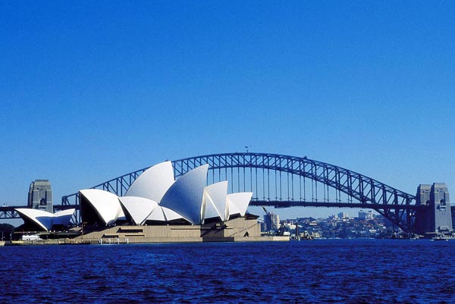
Listening to the world
Listening
After you listen
3
Work in pairs and discuss the questions.
1 Which of the three cities do you like most? Why?
I like Sydney mainly because of its beautiful harbor, beaches and buildings. I also like its warm weather and café culture.

Slide 29
Listening to the world
Listening
After you listen
3
Work in pairs and discuss the questions.
2 Which other city do you know well? Write down all the positive and negative things about the city. Then take turns to explain why you like or don’t like the city.
The city I choose is Shanghai.
Positive things: great employment options, better education for children, excellent health care, excellent cultural and recreational facilities, convenient public transportation, and colorful nightlife.
Negative things: high living expenses and great pressure.

Slide 30
Listening to the world
Sharing
Listening
Viewing

Slide 31
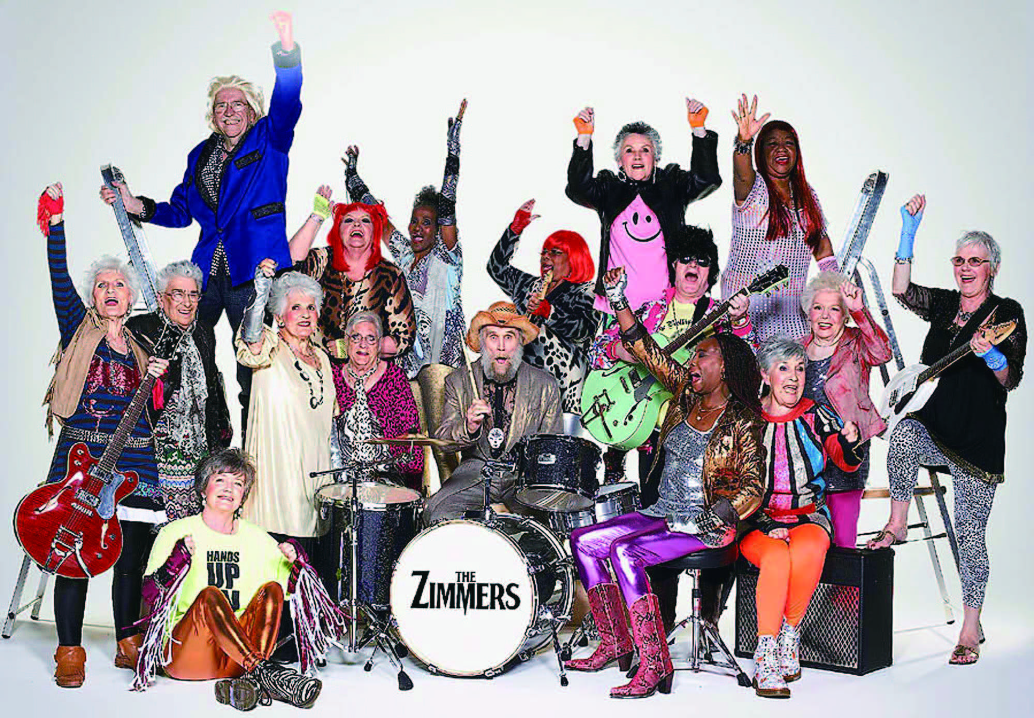
Listening to the world
Viewing
BEFORE you view
1
Read the program information below and answer the questions.
1 Who are The Zimmers? What makes them different from other rock groups?
The Zimmers are a British rock band.
The band is very different from other rock groups in that it is the world’s oldest rock band, with the members’ combined age exceeding 3,000.

Slide 32
Listening to the world
Viewing
BEFORE your view
1
Read the program information below and answer the questions.
2 How did The Zimmers become famous?
They recorded a version of The Who’s song “My Generation” in the famous Abbey Road Studios, which earned them great popularity on YouTube, and then got invited to appear on America’s biggest chat show in Hollywood.

Slide 33
Listening to the world
Viewing
WHILE your view
2
Read the statements. Then watch the video clip and fill in the blanks.
1 a combined age
3 40
2 forgotten; stuck indoors; felt right; 16 times; closure
4 available online; Two million

Slide 34
Listening to the world
Viewing
AFTER your view
3
Work in pairs and discuss the questions
1 How do you think The Zimmers changed these old people’s lives?
The Zimmers have completely changed these old people’s lives. They used to feel lonely, forgotten and cast aside by society. But The Zimmers offered them an excellent opportunity to make friends, to come alive and most important of all, to be heard again by society.

Slide 35
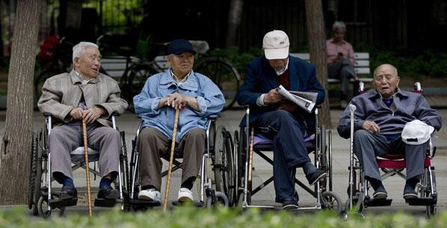
Listening to the world
Viewing
AFTER your view
3
Work in pairs and discuss the questions
2 What problems do old people in China have?
Who will take care of them when they are in need of help and care?
the 4-2-1 type;
a social issue caused by many other practical problems in society.

Slide 36
Listening to the world
Viewing
AFTER your view
3
Work in pairs and discuss the questions
3 What do you think of the amendment of the law? Can you think of better ways to improve old people’s lives in China?
I think the intention of the law is good, but it will do little to change the status quo.
some details are vague ; no clarification of the penalties
too much pressure on migrant workers
may cause more family conflicts and resentment toward elderly parents
People have to establish more day-care centers; hire aides.

Slide 37
Speaking for communication
Role-play
1
Read the questions. Then listen to three conversations and answer the questions.
Conversation 1
1 Q: Where are the speakers?
In a hotel.
2 Q: What is the problem?
The air conditioning doesn’t work.
3 Q: What does the receptionist offer to do?
She will send someone up to look into it.

Slide 38
Speaking for communication
Role-play
1
Read the questions. Then listen to three conversations and answer the questions.
Conversation 2
1 Q: Where are the speakers?
In a restaurant.
2 Q: What is the problem?
They waited about 20 minutes for a table they booked, another hour for their meal, and were asked to pay the service charge.
3 Q: What reason does the manager give?
It was a very busy time of year.

Slide 39
Speaking for communication
Role-play
1
Read the questions. Then listen to three conversations and answer the questions.
Conversation 3
1 Q: Where are the speakers?
In a train station.
2 Q: How long has the woman waited?
She has waited for over an hour.
3 Q: Why is she surprised?
Because the man said the train was delayed because of “the wrong type of snow”.

Slide 40

Speaking for communication
Role-play
2
Read the table. Then listen to the conversation and write C for complaints and R for responses in the right column.
1 C
2 C
3 R
4 R
5 C
6 R

Slide 41
Speaking for communication
Role-play
Speaking skills
Additional Tips
Making and responding to complaints
Making complaints
Use some polite expressions Excuse me, there seems / appears to be something wrong with ... I’m sorry to say this, but I’m not at all happy with … I wonder if you could help me with … Informal expressions • I’m rather annoyed about … • I’m disturbed about … • I cannot put up with … • I’ve had enough of … • It was time you did … • I’m fed up with (someone doing) something …

Slide 42
Speaking for communication
Role-play
Speaking skills
Additional Tips
Making and responding to complaints
Responding to complaints
Use some polite expressions I can’t tell you how sorry I am, I apologize for the inconvenience … I can understand how disappointed you must be about … Well, I’m afraid there isn’t much we can do about it right now. I’m afraid we can’t help you at the moment.

Slide 43
Speaking for communication
Role-play
3
Role-play the situations.
Situation 1
The fridge doesn’t work.
A: Hello. Could you help me? There’s a problem with the fridge.
B: Oh yes?
A: I’ve just tried to turn it on, but it doesn’t work.
B: OK, we’ll look into it right away. I’ll send someone up. It’ll be about five minutes, OK?
A: Thanks.
B: You’re welcome. And sorry about that.

Slide 44
Speaking for communication
Role-play
3
Role-play the situations.
Situation 2
You served me the wrong dish!
A: Hello. Could you help me?
B: Yes?
A: I asked for pasta with chicken. But I was given pasta with fish.
B: I’m terribly sorry for the mistake. I will bring the right dish in five minutes.
A: Thanks.
B: You’re welcome. And again, sorry about that.

Slide 45
Speaking for communication
Role-play
3
Role-play the situations.
Situation 3
What’s wrong with the school facilities?
A:I’m afraid I have a complaint. Could I speak to the director of our school, please?
B:Yes, please go ahead. I’m the director.
A:Good afternoon, sir. I’m sorry to trouble you, but the heat doesn’t work and it is winter.
B:I’m really sorry about that. I’ve already sent some people to look into it.
(To be continued)

Slide 46
Speaking for communication
Role-play
3
Role-play the situations.
(Continued)
A:Thank you. And another thing I have to say is that the equipment in the Self Access Center is faulty.
B:I’m sorry but there’s nothing we can do at the moment. We know some equipment there is beyond repair, and we plan to purchase some new equipment but the funds have not been approved yet.
A:That’s too bad. Anyhow, thank you.
B:You’re welcome.

Slide 47
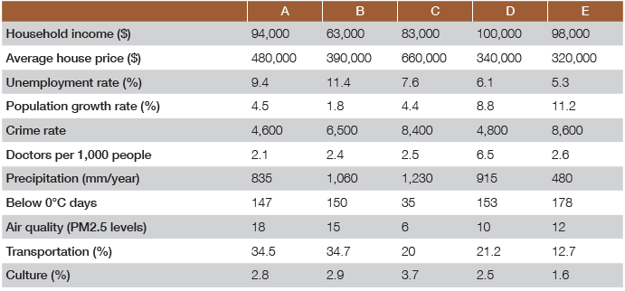
Speaking for communication
Group discussion
Get ideas
1
Study the statistics.

Slide 48
Speaking for communication
Group discussion
Discuss and organize ideas
2
Take notes in the table.
Cities | Pros | Cons
A
• High household income (Rank: 3)
• Low crime rate (Rank: 5)
• Good public transportation (Rank: 2)
• Good cultural atmosphere (Rank: 3)
High average house price (Rank: 2)
High unemployment rate (Rank: 2)
Fewer doctors per 1,000 people (Rank: 5)
Poor air quality (Rank: 1)

Slide 49
Speaking for communication
Group discussion
Discuss and organize ideas
2
Take notes in the table.
Cities | Pros | Cons
B
• Reasonable average house price (Rank: 3)
• Comparatively lower crime rate (Rank:3)
• Good public transportation (Rank: 1)
• Good cultural atmosphere (Rank: 2)
• Low household income (Rank: 5)
• High unemployment rate (Rank: 1)
• Fewer doctors per 1,000 people (Rank: 4)
• Poor air quality (Rank: 2)

Slide 50
Speaking for communication
Group discussion
Discuss and organize ideas
2
Take notes in the table.
Cities | Pros | Cons
C
• Reasonable population growth rate (Rank: 4)
• Good air quality (Rank: 5)
• Pretty good public transportation (Rank: 4)
• Good cultural atmosphere (Rank: 1)
• Relatively lower household income (Rank: 4)
• High average house price (Rank: 1)
• Higher unemployment rate (Rank: 3)
• Higher crime rate (Rank: 2)
• Fewer doctors per 1,000 people (Rank: 3)

Slide 51
Speaking for communication
Group discussion
Discuss and organize ideas
2
Take notes in the table.
Cities | Pros | Cons
D
• High household income (Rank: 1)
• Lower average house price (Rank: 4)
• Lower unemployment rate (Rank: 4)
• Lower crime rate (Rank: 4)
• More doctors per 1,000 people (Rank: 1)
• Good air quality (Rank: 4)
• Pretty good public transportation (Rank: 3)
• Higher population growth rate (may create problems) (Rank: 2)
• Relatively poor cultural atmosphere (Rank: 4)

Slide 52
Speaking for communication
Group discussion
Discuss and organize ideas
2
Take notes in the table.
Cities | Pros | Cons
E
• High household income (Rank: 2)
• Lower average house price (Rank: 5)
• Low unemployment rate (Rank: 5)
• Less rain (Rank: 5)
• Good air quality (Rank: 3)
• High crime rate (Rank: 1)
• Fewer doctors per 1,000 people (Rank: 2)
• Higher population growth rate (may create problems) (Rank: 1)
• Poorer public transportation (Rank: 5)
• Poorer cultural atmosphere (Rank: 5)

Slide 53
Speaking for communication
Group discussion
Discuss and organize ideas
3
Recommend the best city to live in and give reasons.
City D
• high household income;
• low living expenses (lower house prices);
• better employment opportunities (lower unemployment rate)
• better security (lower crime rate)
• better health care (more doctors per 1,000 people)
• good air quality (lower PM2.5);
• pretty good public transportation (higher percentage of the workforce utilizing public transport)

Slide 54

Speaking for communication
Group discussion
Present ideas
4
Present your ideas to the class.

Slide 55
Further practice in listening
Short conversations
1 Q: What attracts the woman most in a big city?
A Access to various forms of entertainment.
2 Q: What do we know from what the woman said?
A She prefers outdoor parking.
3 Q: What does the woman imply?
B Big cities are now gradually losing their appeal.
4 Q: What does the man say about the aging problem?
A The aging problem emerges earlier than expected.
5 Q: What does the woman think about the people living in big cities?
D They are more likely to have mental problems.

Slide 56
Further practice in listening
Long conversation
1 Q: What is Emily going to do?
A She is going to move to Santa Fe.
2 Q: What did Emily think life in Santa Fe would be like?
A It is tedious.
3 Q: What is unique in Santa Fe according to the man?
D Its history.
4 Q: What attracts artists around the world to Santa Fe?
B Its colorful scenery.

Slide 57
Further practice in listening
Passage 1
1 Q: What shocked the speaker?
B That parents buy their young kids expensive electronic
products.
2 Q: What is appropriate for slightly older kids according to the speaker?
D Old-fashioned paper books.
3 Q: What is the best thing about iPads according to the couple?
C They keep children at different age levels occupied.
4 Q: What does the speaker think of buying iPads for kids after talking with the couple?
D It is understandable.

Slide 58
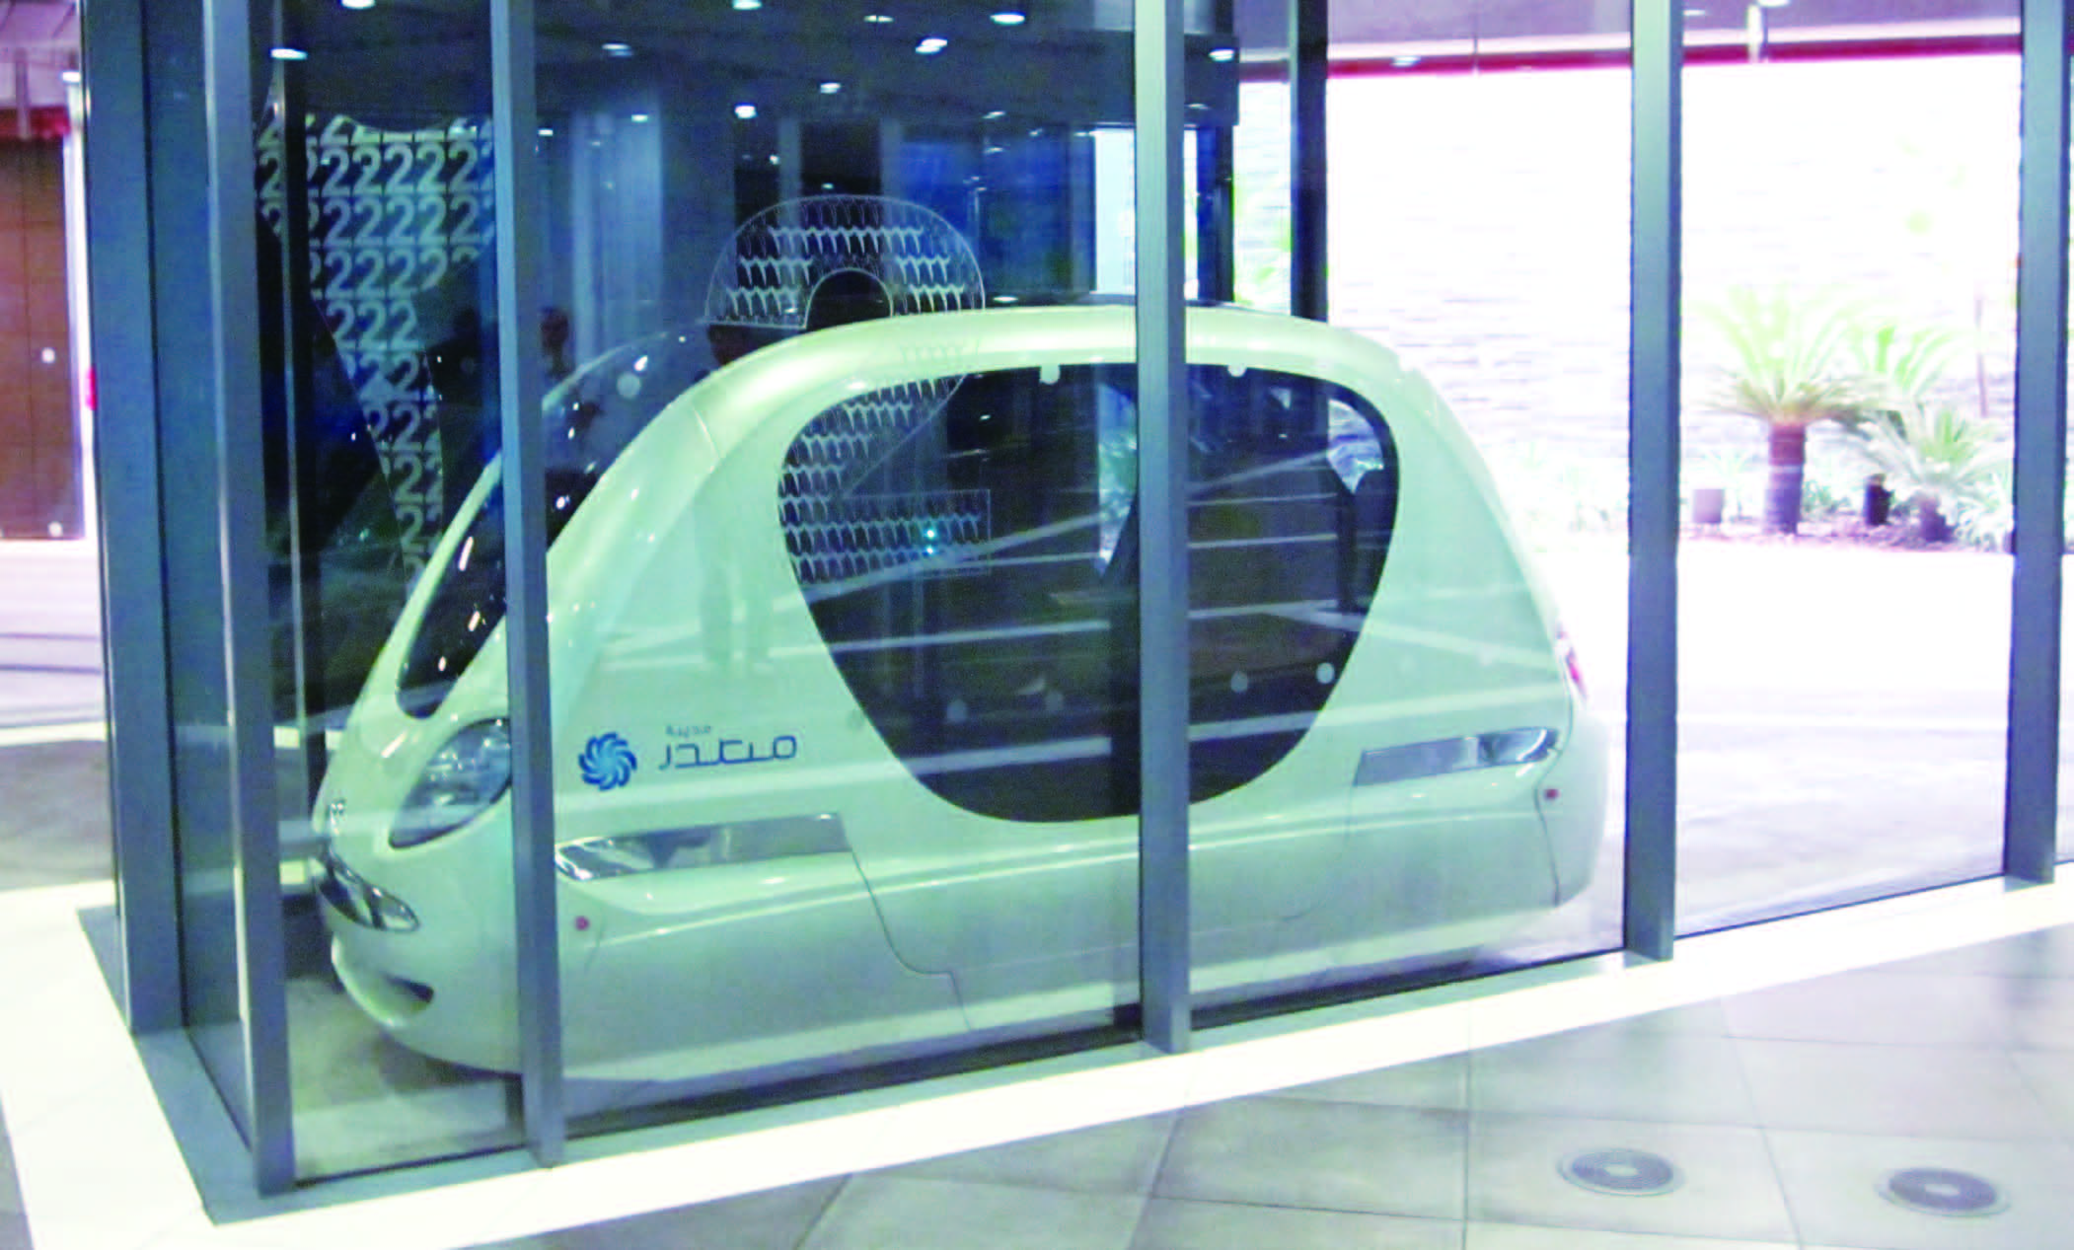
Further practice in listening
Passage 2
1) join up
2) reaction
3) makes increasing sense
4) sustainable
5) aims
6) monitored
7) access to
8) experimenting with
9) eye-catching
10) commuting

Slide 59
Wrapping up
Use the following self-assessment checklist to check what you have learned in this unit.
Skills | OK | Needs work
I can talk about different aspects of city life.
I can understand pros and cons while listening.
I can make and respond to complaints.
I can discuss the pros and cons of a city.

Slide 60
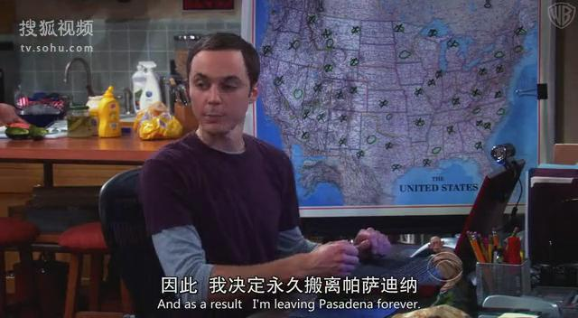
Fun time
Enjoy an video clip from The Big Bang Theory.

